Slide 1
A Statistical Algorithm for Linguistic Steganography Detection Based on Distribution of Words
Bộ môn Khoa Học Máy Tính
Khoa Công Nghệ Thông Tin
Nguyễn Xuân Huy - 0712196
Trần Văn Tiến - 0712446

Slide 2
Mindmap

Slide 3
Nội dung
Linguistic Steganography Detection
Distribution of Words
Support Vector Machine
Result

Slide 4
Linguistic Steganography Detection

Slide 5
Steganography Method
Steganography Method
NICE TEXT
TEXTTO
Markov Chain
Detect Method

Slide 6
NICETEXT
Watermark : ‘0110’
Style Template
Dictionary:
Ex : 101 -> midfielder take a pass.
Style | Type | Bit | Word
Footballer Fb_Verb Fb_Object | Footballer | 0 | striker
 |  | 1 | midfieldes
 | Fb_Verb | 0 | take
 |  | 1 | stop
 | Fb_Object | 0 | a pass
 |  | 1 | a shot

Slide 7
TEXTTO
Watermark : ‘abc’
Struct :
The _ADJECTIVE _THING _VERBs _ADVERB in the _PLACE.I _VERB _ADJECTIVE _THINGs near the _ADJECTIVE _ADJECTIVE _PLACE.
Dictionary :
1..9 -> 1..9
a..z -> 10..35
A..Z -> 36..61
+,- … -> 62…
Ex : “iluvu”→ 18 21 30 31 30
→ The mad referre decide wrongly in the stadium.
TYPE | Index | Word
THING | 21 | referre
ADVERB | 31 | wrongly
VERB | 30 | decide
ADJECTIVE | 18 | mad
PLACE | 30 | stadium

Slide 8
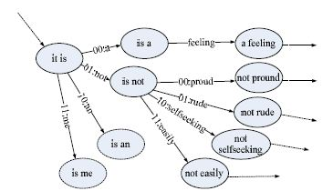
Markov Chain

Slide 9


Detect Problem 1.0
Input :
text file .
Output :
is it a stego file ?
Notes:
Te

Slide 10
Distribution of Words

Slide 11

Text segment :
Example :
Wherever you go ,whoever you will be. I will be right here waiting for you . (n=15)
S = {‘wherever’, ‘you’, ‘go’, ‘whoever’, ‘you’, ‘will’, ‘be’, ‘i’, ‘will’, ‘be’, ‘right’, ‘here’, ‘waiting’, ‘for’, ‘you’ }

Slide 12
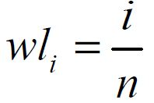
Word Location:
Example :
wl₀ = 0/15 = 0 (‘whatever’)
wl₁ = 1/15 = 0.067 (‘you’)
wl₂ = 2/15 = 0.133 (‘do’)
wl₄ = 4/15 = 0.266 (‘you’)
wl₁₄ = 14/15 = 0.933 (‘you’)

Slide 13
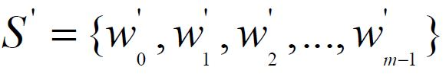

Represent for distinct words
Example :
S’ = {‘wherever’, ‘you’, ‘go’, ‘whoever ’, ‘will’, ‘be’, ‘i’, ‘right’, ‘here’, ‘waiting’, ‘for’ } (m=11)
WL(w’₀ ) = { 0 } (‘wherever’)
WL(w’₁ ) = {0.067, 0.266, 0.933 } (‘you’)

Slide 14
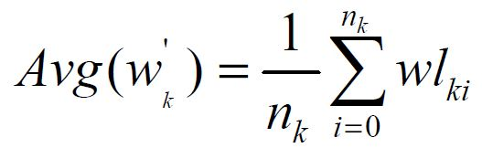
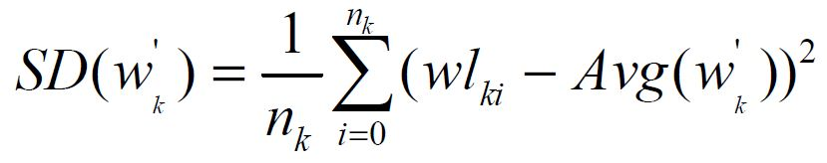
Detect Problem 1.1

Slide 15
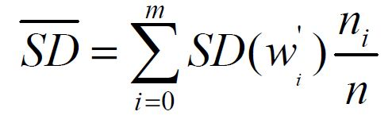
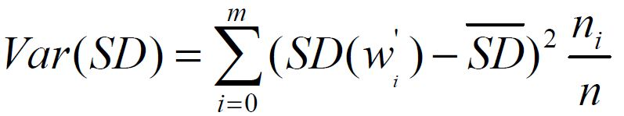

Slide 16
Support Vector Machine

Slide 17
What is SVM ?
Set of related supervised learning methods.
Analyze data and recognize patterns.
Use hyperplane and kernel Function

Slide 18



How it work ?
Class : apples <> pearls.
Attribute : weight , length .
Classifier :
Classifier
choose
[ weight , length ]
choose

Slide 19
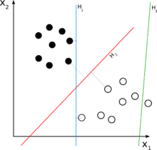

Demo
Hyperplane
H₁: Hyperplane
H₂ : Classifying
Hyperplane
H₃: not Hyperplane
length
weight

Slide 20
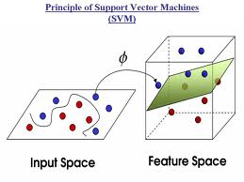
Learning Machine
Kernel Function

Slide 21
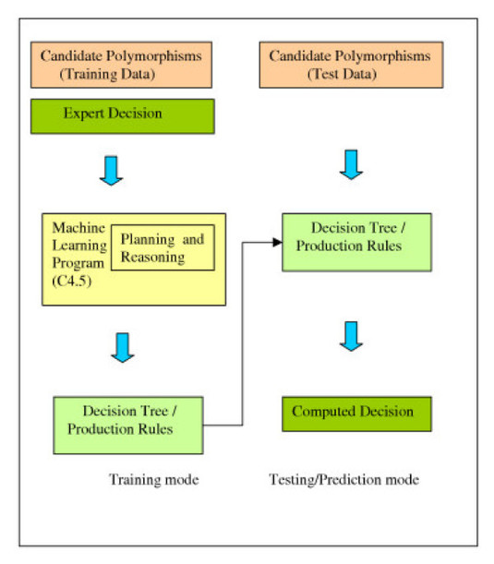
SVM Learning Machine
SVM

Slide 22
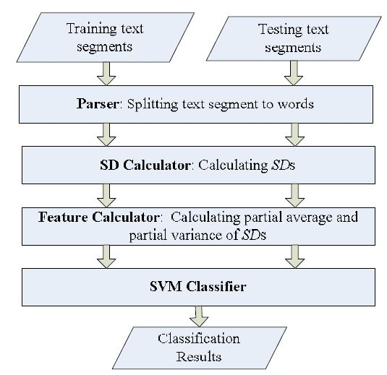
SVM Learning Machine

Slide 23
Classification Result
>=85% success :
Steganography text file can be detected by its average and variance of SD .
< 85% success :
Steganography text file can not be detected by its average and variance of SD .

Slide 24
Train & Test

Slide 25
Data Input

Slide 26
Result Output

Slide 27
Result Output

Slide 28
Result Output

Slide 29
Result Output

Slide 30
Result Output

Slide 31
Result Output

Slide 32
Result

Slide 33
Summary

Slide 34
Demo

